Slide 1
Greatness in the Kingdom
Kingdom Character
(Matt 5:1-12)
Kingdom
Calling
(Matt 5:13-16)
Kingdom Conduct
(Matt 5:17-7:27)

Slide 2
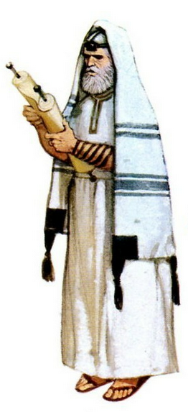
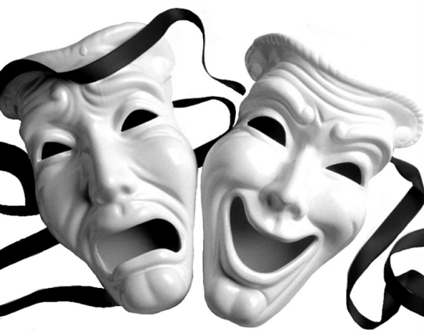
Greatness in the Kingdom
… must
surpass
that of the Scribes and Pharisees …
(Matthew 5:20)
… not as the hypocrites do ...
(Matthew 6:1-2)
Righteousness Warnings

Slide 3
Greatness in the Kingdom
In the same way, let your light shine before others, so that they
may see your
good works
(Matt 5:16)
Beware of practicing your righteousness before other people in order to be
seen by them
(Matt 6:1)
Righteousness Warnings

Slide 4
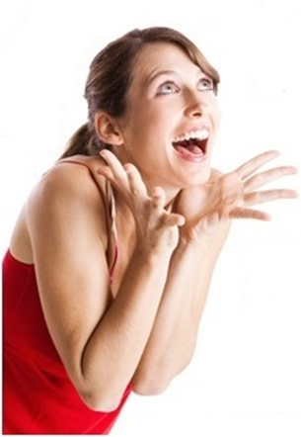
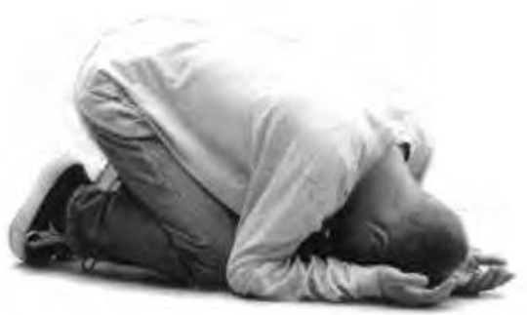
Greatness in the Kingdom
Whose?
the Father’s?
the world’s?
Righteousness Warnings

Slide 5
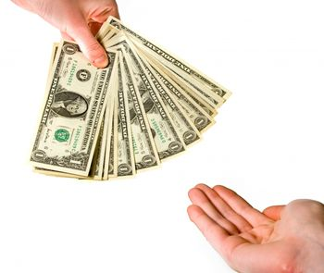
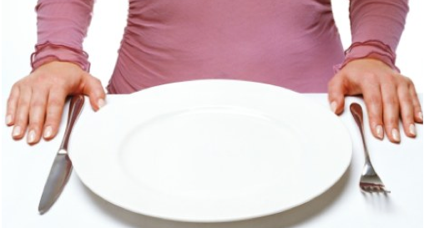
Greatness in the Kingdom
… this has implications for how we …
… give …
(Matt. 6:2-4)
… pray …
(Matt. 6:5-15)
… fast …
(Matt. 6:16-18)
Righteousness Warnings

Slide 6
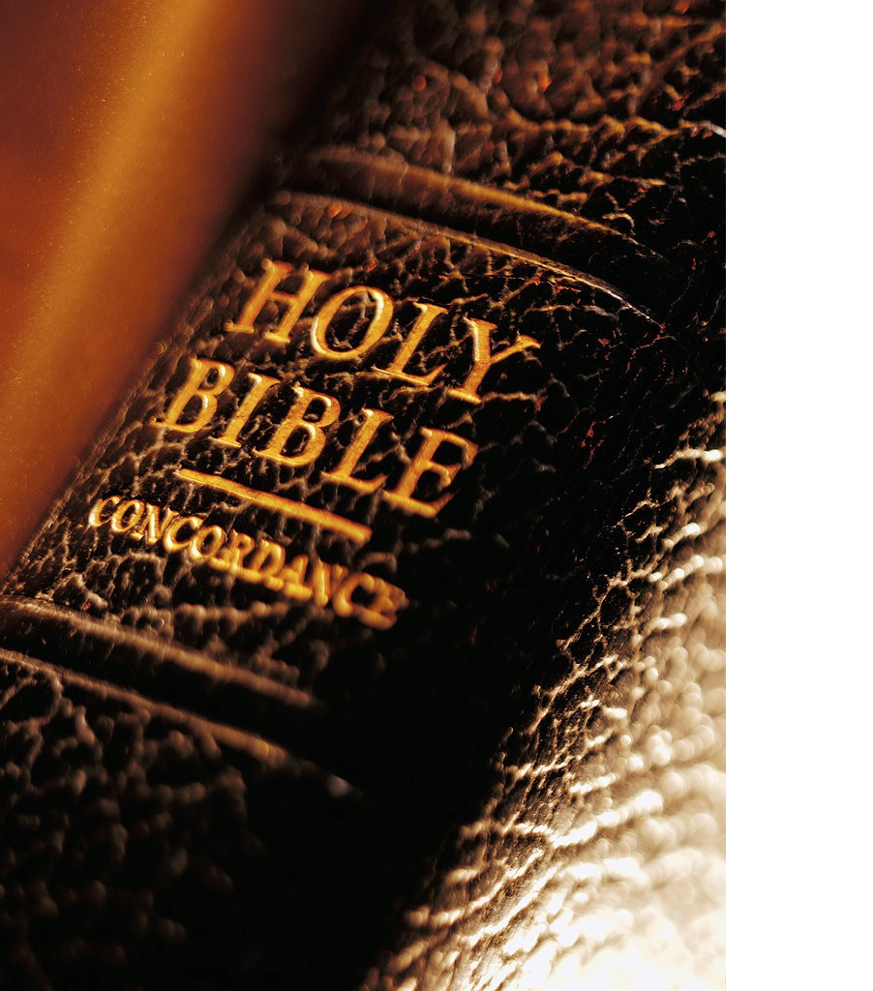
Matthew 6:1-4 (NLT)
⁵ “When you pray, don’t be like the hypocrites who love to pray publicly on street corners and in the synagogues where everyone can see them. I tell you the truth, that is all the reward they will ever get. ⁶ But when you pray, go away by yourself, shut the door behind you, and pray to your Father in private. Then your Father, who sees everything, will reward you.

Slide 7
Matthew 6:1-4 (NLT)
⁷ “When you pray, don’t babble on and on as people of other religions do. They think their prayers are answered merely by repeating their words again and again. ⁸ Don’t be like them, for your Father knows exactly what you need even before you ask him! ⁹ Pray like this: Our Father in heaven, may your name be kept holy.

Slide 8
Matthew 6:1-4 (NLT)
¹⁰ May your Kingdom come soon. May your will be done on earth, as it is in heaven. ¹¹ Give us today the food we need, ¹² and forgive us our sins, as we have forgiven those who sin against us. ¹³ And don’t let us yield to temptation, but rescue us from the evil one.

Slide 9
Matthew 6:1-4 (NLT)
¹⁴ “If you forgive those who sin against you, your heavenly Father will forgive you. ¹⁵ But if you refuse to forgive others, your Father will not forgive your sins.

Slide 10
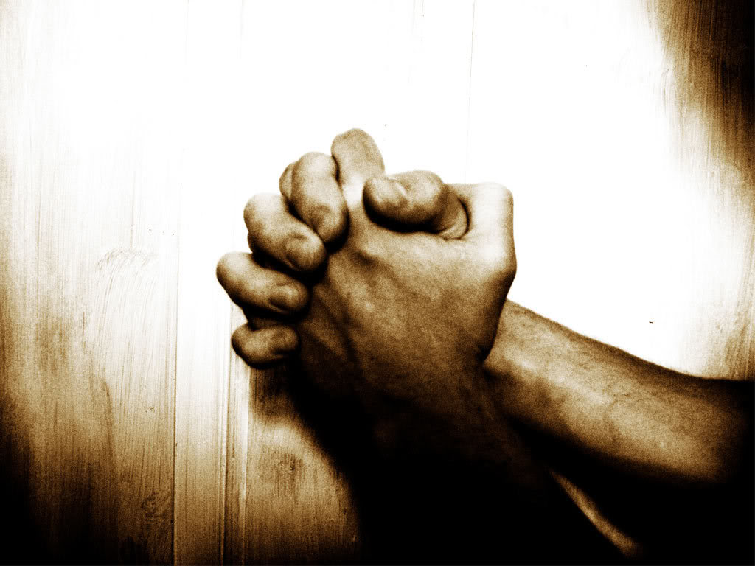
Greatness in the Kingdom
2 warnings
e
example
When you pray …
(Matt 6:5,6,7)

Slide 11
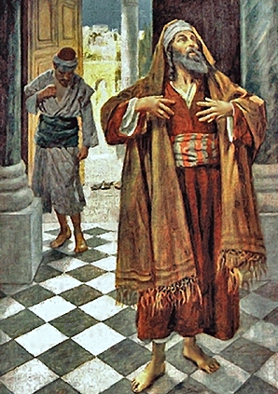
Greatness in the Kingdom
First Warning
For they love to … pray … that they may be seen by others. (Matthew 6:5)
Not like the hypocrites …
(Matt 6:5)

Slide 12
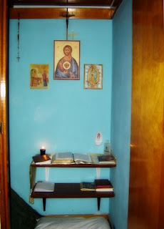
Greatness in the Kingdom
First Warning
For they love to … pray … that they may be seen by others. (Matthew 6:5)
But when you pray, … pray to your Father in private. (Matthew 6:6)
Not like the hypocrites …
(Matt 6:5)

Slide 13
Greatness in the Kingdom
Second Warning
And when you pray, do
not keep on babbling like pagans
(Matthew 6:7)
Not like the pagans …
(Matt 6:7)

Slide 14
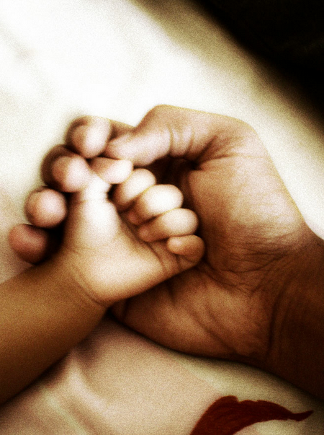
Greatness in the Kingdom
Second Warning
And when you pray, do
not keep on babbling like pagans
(Matthew 6:7)
Your Father knows ...
before you ask him. (Matthew 6:8)
Not like the pagans …
(Matt 6:7)

Slide 15
Greatness in the Kingdom
Our Father
(6:9)
Your …
Us …
name be hallowed
(6:9)
daily bread given
(6:11)
kingdom come
(6:10)
forgive sins
(6:12)
will be done
(6:10)
deliver from evil
(6:13)
Pray like this…
(Matt 6:9)

Slide 16
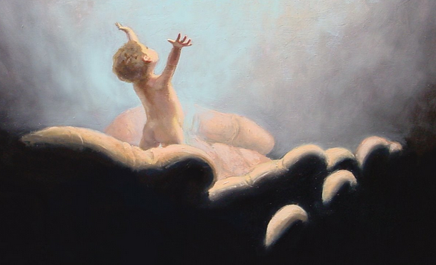
Greatness in the Kingdom
Our Father in heaven …
(6:9)
Pray like this…
(Matt 6:9)

Slide 17
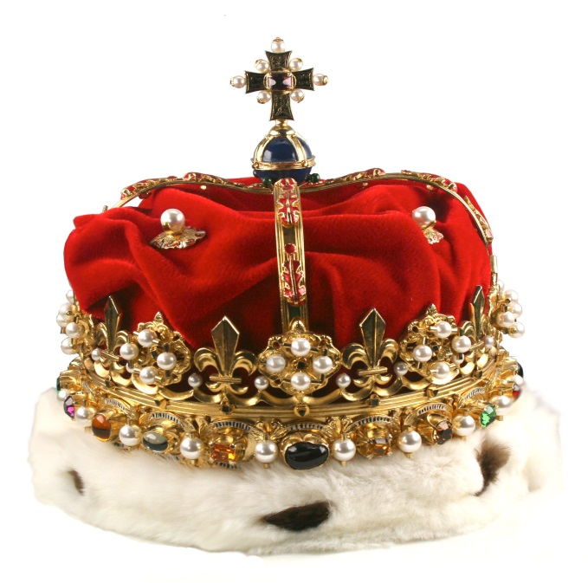
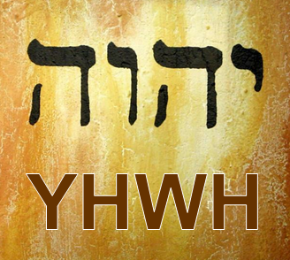
Greatness in the Kingdom
name hallowed
(6:9)
kingdom come
(6:10)
will
done
(6:10)
… on earth as it is in heaven …
Pray like this…
(Matt 6:9)

Slide 18
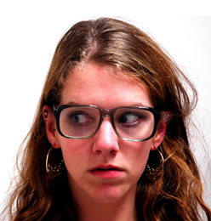
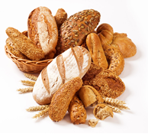
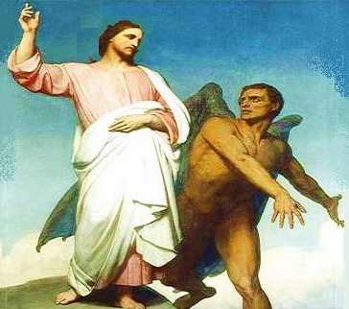
Greatness in the Kingdom
body
present
soul
past
spirit
future
provision
(6:11)
forgiveness
(6:12)
deliverance
(6:13)
Pray like this…
(Matt 6:9)

